Slide 1
Crowds
Digital Communities and the Public
Notes:
Kind of a broad topic – it’s hard to define and it spills over into other areas

Slide 2
The Digital Space/Community
Drawing from Erving Goffman’s interaction order and some of the theories surrounding his work, the virtual space allows actors, rather than meet in a physical time and place, to meet specifically in time.

Slide 3
Presentation of the Self
Our daily lives cannot easily be separated from the digital lives we construct. Across a variety of platforms we present elements of our self to an audience and interact with other people. Even though this happens in a digital space the information that emerges from these interactions is just as important as what emerges from face to face interactions. The information is also highly valuable to companies and governments who want to know more about their consumers or citizens.
At the same time, we have the potential to maintain a degree of anonymity when online depending on the platforms and tools we use.

Slide 4
Community as an Overused Concept
Bridget Draxler and Jon Winet in “Community” point out Miranda Joseph’s criticism of the concept of community as overused and essentially without meaning. While Draxler and Winet acknowledge the flaws they believe that it is still worth celebrating.
Similar to Brubaker and Cooper’s “Beyond Identity” (2000), in which they propose a set of alternative idioms such as identification, commonality, categorizations, and self-understanding which come to do the work traditionally reserved for identity.
What are some of the possible replacement terms for community that might make digital ‘communities’ and crowds a little less challenging?

Slide 5
Defining Community and Crowds
Community :
Crowds:
Alternatives concepts?

Slide 6
Traditional Communities vs Virtual Communities
Physical
Limitations:
Affordances:
Virtual
Limitations:
Affordances:

Slide 7
Some Crowdsourcing Projects
Amara - Allows anyone anywhere to offer their skills as translators.
OpenStreetMap – Free editable map of the world – has a nice human touch.
Waze – Free GPS application that incorporates real time updates from users.
Encyclopedia of Life - A collaborative encyclopedia intended to document all the species know to science. It incorporates content from experts and non-experts alike.

Slide 8
Wikipedia
Greater emphasis on people, dates, and major events.
Minor errors occur despite the wide variety of contributors – many errors are simply repetitions of commonly held beliefs.
Reveals areas of interest for the general public.
Quality of writing is not on par with professionally written encyclopedias.
The more contributors working on an article the stronger it becomes.
Information reflects commonly held knowledge – no groundbreaking research

Slide 9
Rules and Violations
Violations of the rules are not as prevalent as one might expect. I personally see this as a reflection of Goffman’s assertion that people generally sacrifice some aspects of their freedoms in the name of order. The people who violate the interaction order are still dependent on the order itself.
So long as the violations are not systemic, the general order is maintained by the collective.

Slide 10
Jack Johnson
Please visit the Wikipedia as well as the Encyclopedia Britannica pages for Jack Johnson (Boxer).
Begin with the Encyclopedia Britannica page and read the initial profile, taking note of both form and content. Please use Hypothesis to take notes.
Continue to read through the content of the article and indicate any peculiarities that you notice. Ex: What takes up the most amount of space or how much time is dedicated to specific events?
Discuss with the article with person next to you - Is this good writing? Does it convey a sense of who Jack Johnson was? Does it say anything about the authors of the article or general public’s interest?
Repeat process with the Wikipedia article.

Slide 11
Social ‘Facts’
When we offer the public the chance to write about local and national histories, individuals, organizations, etc.. we also gain access to a wealth of information.
Durkheim’s concept of the social fact is useful when trying to find meaning in the content produced by the public. As a collaborative project, Wikipedia reveals a collective interpretation of commonly held knowledge.
What are some of the ‘social facts’ that might be identifiable thanks to digital crowds? What behaviors, beliefs, or values might become apparent?

Slide 12
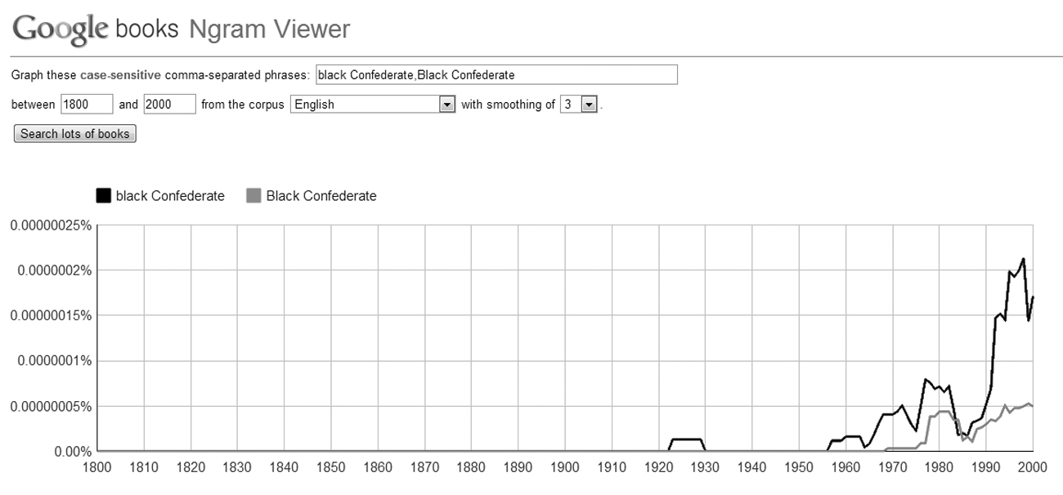
How can we learn from bias, poor writing, and misperception?
‘The Wisdom of Crowds(ourcing)’, in Writing History in the Digital Age, Kristen Nawrotzki; Jack Dougherty eds. 2013. DigitalCultureBooks, Ann Arbor.
Notes:
Spike in the 1990s as a means of justifying support for confederate without openly admitting to white supremacy. As more people develop skills online, and contribute content, the potential for misperception to circulate increases. Rumor communities develop and propagate myths.

Slide 13
Misperception and Rumor Communities
What is it about digital communities that allows for rumor and misperception to spread?
Access to publishing tools – easy exchange of information.
Serve as echo chambers – attracts those with similar ideologies.
False sense of authority over topic – lack of expertise.
Social networking and social media allows for individuals to seek out users with similar interests.
What needs to be done?
Public education (critical literacy)
Academic engagement with public.
…

Slide 14
Education
Grinnell Beowulf project – helps to produce a sense of imagined community with those who are actively engaged in the production of the text as well as with those who may visit and contribute to it in the future.
AnnoTate – Offers participants training and hands on experience with transcribing and annotating documents.
Project oriented approaches to learning are highly beneficial as it allows students to directly engage with materials and tools rather than at a theoretical level.

Slide 15
Education continued…
Training and development are offered in some cases, allowing participants to gain knowledge and skills outside of traditional environments (AnnoTate offers a guide).
Projects like Wikipedia, while not the most exhaustive sources, still offer information to a wider audience than traditional encyclopedias. What matters is that everyone is able to access it .
Engagement with non-academic ‘communities’ becomes easier through digital projects. Social network and social media sites offer a means of disseminating information.

Slide 16
Concluding Thoughts – A Word on Labor
Terms like playbor point to the blurring of the boundaries between labor and leisure time.
Crowdsourcing can unsettle already established areas of the labor market (ex: photography)
A bit like the early days of industrialization – if you don’t do it, we can find someone else to do it.
Requires regulation and oversight to ensure fair and ethical treatment of laborers

Slide 17
Further Reading
Draxler, Bridget and Jon Winet. ‘Community’ Digital Pedagogy in the Humanitieshttps://digitalpedagogy.mla.hcommons.org/keywords/community/
Roy Rosenzweig, “Can History be Open Source? Wikipedia and the Future of the Past”, http://chnm.gmu.edu/essays-on-history-new-media/essays/?essayid=42
Any piece in part 2, ‘The Wisdom of Crowds(ourcing)’, in Writing History in the Digital Age, Kristen Nawrotzki; Jack Dougherty eds. 2013. DigitalCultureBooks, Ann Arbor. http://quod.lib.umich.edu/d/dh/12230987.0001.001/1:5/--writing-history-in-the-digital-age?g=dculture;rgn=div1;view=fulltext;xc=1

